Slide 1

Transaction (2)

Slide 2
ACID Properties
A transaction is a very small unit of a program and it may contain several low level tasks. A transaction in a database system must maintain Atomicity, Consistency, Isolation, and Durability − commonly known as ACID properties − in order to ensure accuracy, completeness, and data integrity.
Atomicity − This property states that a transaction must be treated as an atomic unit, that is, either all of its operations are executed or none. There must be no state in a database where a transaction is left partially completed. States should be defined either before the execution of the transaction or after the execution/abortion/failure of the transaction.
Consistency − The database must remain in a consistent state after any transaction. No transaction should have any adverse effect on the data residing in the database. If the database was in a consistent state before the execution of a transaction, it must remain consistent after the execution of the transaction as well. (Valid Data)

Slide 3
ACID Properties
Durability − The database should be durable enough to hold all its latest updates even if the system fails or restarts. If a transaction updates a chunk of data in a database and commits, then the database will hold the modified data. If a transaction commits but the system fails before the data could be written on to the disk, then that data will be updated once the system springs back into action.
Isolation − In a database system where more than one transaction are being executed simultaneously and in parallel, the property of isolation states that all the transactions will be carried out and executed as if it is the only transaction in the system. No transaction will affect the existence of any other transaction. (Multiple Transacition Control)

Slide 4
Atomicity means that a transaction in a database should be all-or-nothing. This means that either every part of the transaction is completed successfully, or none of it happens at all.
If a transaction fails or is canceled, the database should not end up in a mixed state where some changes are applied and some are not.
The database should be either in its original state before the transaction started or in a new state after the transaction is fully finished or canceled.
Durability means that once a transaction is successfully completed, the changes it made to the database are permanent, even if there’s a system failure (like a power outage or crash).
After the transaction finishes, the updates are safely stored and won't be lost.
The database will keep the changes no matter what happens afterward.

Slide 5
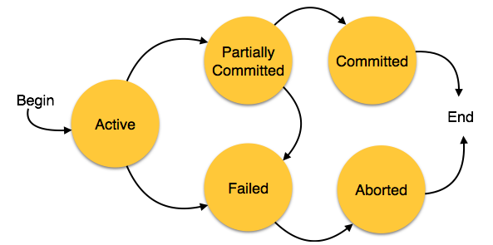
States of Transactions
A transaction in a database can be in one of the following states −
RAM HD

Slide 6
States of Transactions
Active − In this state, the transaction is being executed. This is the initial state of every transaction.
Partially Committed − When a transaction executes its final operation, it is said to be in a partially committed state.
Failed − A transaction is said to be in a failed state if any of the checks made by the database recovery system fails. A failed transaction can no longer proceed further.

Slide 7
States of Transactions
Aborted − If any of the checks fails and the transaction has reached a failed state, then the recovery manager rolls back all its write operations on the database to bring the database back to its original state where it was prior to the execution of the transaction. Transactions in this state are called aborted. The database recovery module can select one of the two operations after a transaction aborts −
Re-start the transaction
Kill the transaction
Committed − If a transaction executes all its operations successfully, it is said to be committed. All its effects are now permanently established on the database system.

